Slide 1

E-Commerce
Indra Prashanth SJ ( 2860024 )
Uday Shankar Boddupalli ( 2868122 )

Slide 2
Introduction
Ecommerce-site , a website where you can browse and shop for a wide variety of products. The website offers a user-friendly interface that allows customers to easily search for and purchase items with just a few clicks.
In addition to the shopping platform, it also has an admin module that enables to manage and monitor the website's operations. This module provides with real-time data on product inventory, sales, and customer behavior and also allowing the admin to Add, Delete and Modify the products.
The purpose of this presentation is to showcase the testing performed on Ecommerce website. The agenda for the presentation includes an overview of testing objectives, approach, and results

Slide 3
Software Being Tested
Software Name | Ecommerce
Database: | MySQL 5.x
Language Used: | PHP5.6, PHP7.x
User Interface Design | HTML, AJAX, JQUERY, JAVASCRIPT
Web Browser | Mozilla, Google Chrome, IE8, OPERA

Slide 4
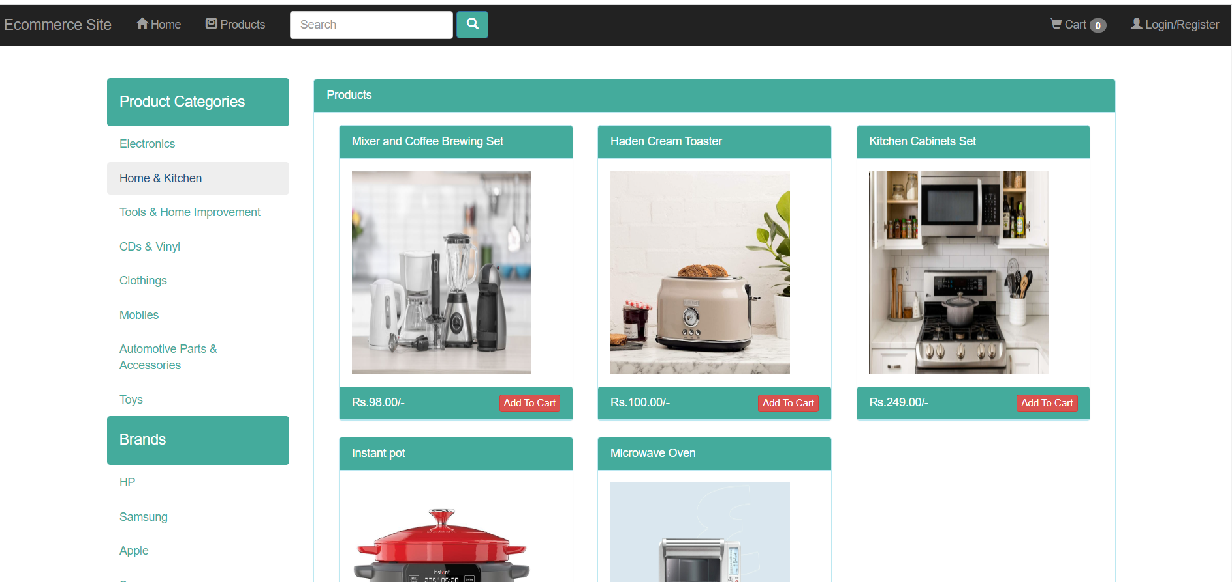
Snapshots of the Software being tested
Customer view:

Slide 5
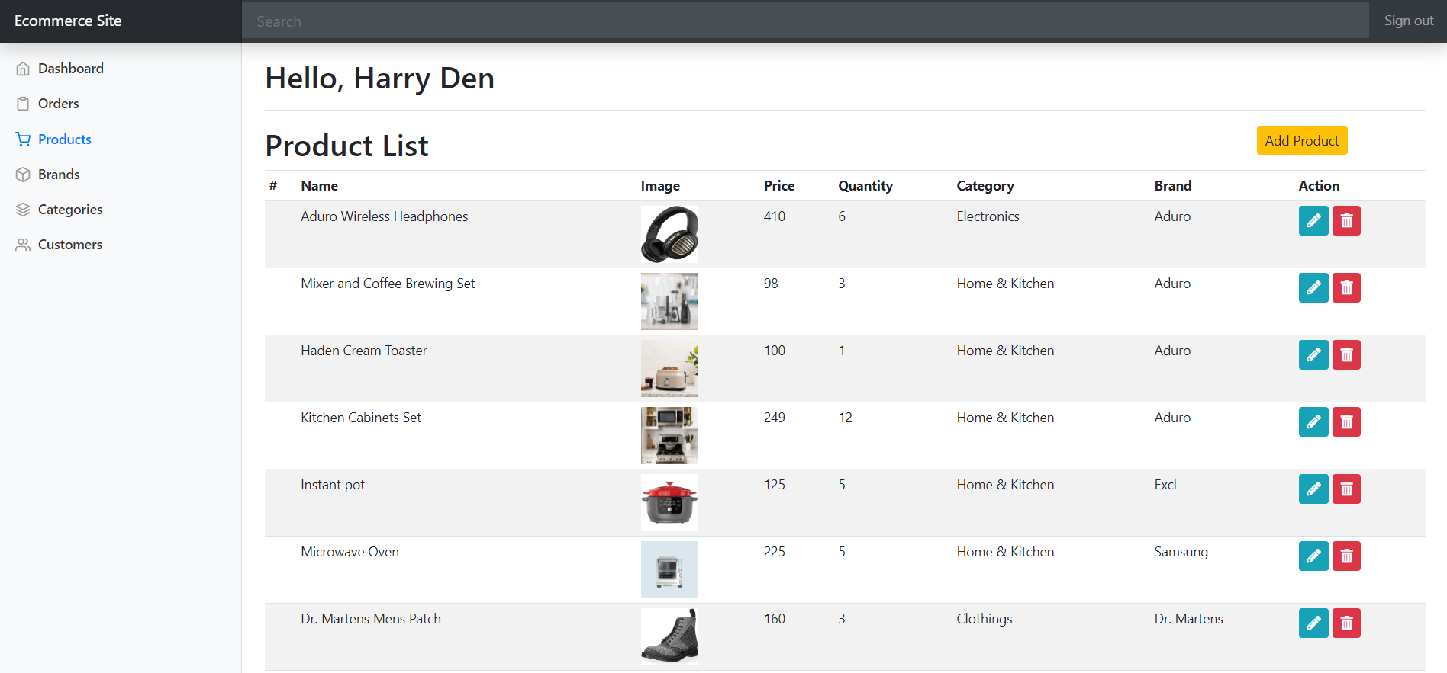
Admin View:

Slide 6
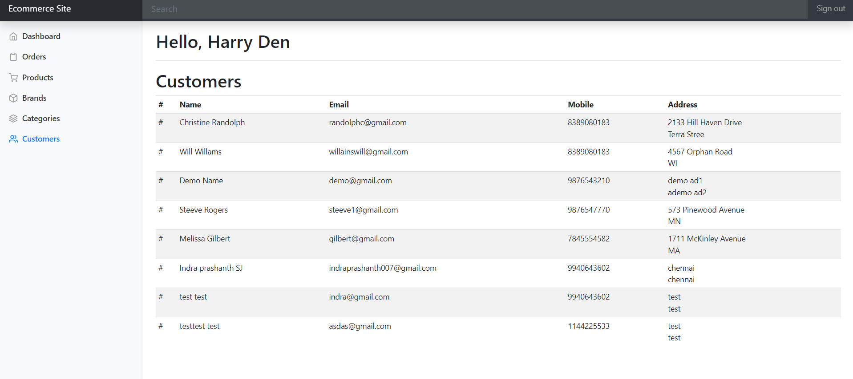

Slide 7
Testing Objectives
Functionality:
The primary objective of functional testing was to ensure that all the features and functions of the ecommerce website is working as intended. This includes testing the website's navigation, links, buttons, search functionality, product pages, shopping cart, checkout process, payment processing, order tracking, and customer account management. This was done to ensure that the website meets the requirements and delivers the intended functionality to users.
Compatibility:
Compatibility testing was done to ensure that the ecommerce website worked correctly across different browsers, devices, and operating systems. The objective was to ensure that the website provided a consistent user experience across different platforms and devices. This involved testing the website on different browsers, mobile devices, and operating systems to identify any compatibility issues. Compatibility testing ensures that the website is accessible to all users, regardless of their device or platform.

Slide 8
Testing Objectives (Contd.)
Usability:
Usability testing is another key testing objective. The testing involved obtaining feedback from actual users to ensure the website is easy to use and meets their needs and expectations. This included testing the website's navigation, layout, and design to ensure it is user-friendly.
Regression testing:
It was focused on ensuring that any changes or updates made to the website do not affect the existing functions of the website and do not introduce any new issues. The objective was to ensure that the website remained stable and continues to provide a seamless user experience after any updates or changes. Regression testing involves testing the website's core functionality and user workflows to identify any regression issues.

Slide 9
Test Design
The test design for the Tested Ecommerce website typically involved following a structured approach that includes identifying functional requirements, creating test scenarios, defining test cases, and prioritizing them. Test cases were designed to cover all the different use cases and user flows of the website and were designed to simulate real-world scenarios that users are likely to encounter. Test cases were broken down into smaller units that focus on specific functions or features of the website, and includes inputs, expected results, and actual results. Prioritization of test cases was important to ensure that critical functions and features were tested first. Overall, a thorough and well-designed test plan was essential and helpful to ensure the testing phase was done smoothly without any dependencies.

Slide 10
Test Case Identifier | TC 008
Test Items/feature | Paypal Testing account Checkout
Preconditions | The user should have products in their cart.
Test Steps | Click on the ‘Checkout’ button on the cart page. Verify that the order summary is displayed correctly. Click on the ‘Place Order’ button.
Output Specifications | The user should be able to place their order successfully and receive an order confirmation.
Inter-case Dependencies | None
Test Result | Pass

Slide 11
Functional Testing
These are the main functionalities that were tested from the Customers perspective.
Customer Perspective Functionalities:
Product Search:
The product search functionality on an Ecommerce website is critical for users to find the products they are looking for. Testing of product search would involve testing the search functionality across a range of different search terms to ensure it returns accurate and relevant results. This functionality was tested thoroughly to ensure that it returns relevant and accurate results for various queries.
Navigation and Browsing Capabilities:
Testing the ability to Search products from different categories. Functional testing of browsing and filtering capabilities would involve testing these filters across a range of products to ensure they work as intended. Ensure that users can easily navigate the website and find what they are looking for.

Slide 12
Functional Testing (Continued)
Product pages:
Ensure that all information on the product pages is accurate and up-to-date.
Account management:
Test the account management functions, including login, registration, and account settings. The user account functionality includes registration, login, and account settings. These functions need to be tested to ensure that they are easy to use and secure.
Payment Gateway Integration:
Payment gateway integration is a critical component of any Ecommerce website. Functional testing of the payment gateway would involve testing the process of completing a transaction using different payment methods. In this case we used the Sandbox PayPal credentials a Testing credit account with testing money, to ensure the transaction is completed smoothly and securely.

Slide 13
Functional Testing (Continued)
Admin Perspective Functionalities
Product management:
This functionality was tested to check if the admin can perform easy and efficient management of product information, including product descriptions, images, pricing, stock levels, and categories.
Order management:
This functionality was tested to check if the admin can perform easy tracking and management of customer orders, including order status, shipping details, and payment information.
Reporting and analytics:
This functionality was tested to check if the admin can perform useful reporting and analytics tools to help ecommerce store to track sales, monitor traffic, and analyze customer behavior.

Slide 14
Functional Testing (Continued)
Inventory Management:
This functionality was tested to check if the admins can view inventory levels, track stock levels, and receive notifications when inventory levels are low. This can be tracked in the products page which displays the Quantity left after each product is sold.
Customization:
This functionality was tested to check if the admin panel should allow for easy customization of the ecommerce platform, including the ability to add custom fields, modify templates, and integrate with third-party tools. This was achieved by adding the new Categories in the admin panel which was then reflected in the Webpage.

Slide 15
Test Report
Execution Rate: 100 %
Pass Rate: 72.22 %
Fail Rate: 27.77 %

Slide 16
Defect Report
Test Case ID | Test Case Name | Comments
TC 009 | Updating account information | The option is unavailable to update the customers information
TC 014 | Order management - Viewing all orders | The orders being placed by the customer is not reflected in the Orders page of the Admin module
TC 015 | Order management - Viewing individual orders | Admin is unable to view the Individual orders placed by the customer.
TC 017 | User management - Editing users | Admin is unable to Edit the Customers information that are registered with the Website. No edit option is available
TC 018 | User management - Deleting user accounts | The Admin is unable to delete the Users that are registered with the Website. No option available to delete.

Slide 17
Test Summary
The testing scope covered all the functionalities of the customer module, including account creation and login, product browsing, shopping cart, checkout, order history, and account management. The testing was conducted on the latest version of the website on different web browsers and devices. The test results indicated that most of the functionalities of the customer module worked correctly, and the user experience was positive. The testing for an ecommerce website admin module involved testing six key functionalities: User Management, Product Management, Inventory Management, Order Management, Payment Management, and Shipping Management. The tests were successful, with most of the functions working correctly and accurately displaying data on the website.

Slide 18
THANK YOU

